Slide 1

Reliability and validity analyzes of Kinect V2 based measurement system for shoulder motions
《Medical Engineering and Physics》
1.471/Q3

Slide 2
Introduction
As stated in the World Health Organization (WHO) media center’s report, there are over 1 billion disabled people in the world.
These patients face many rehabilitation problems such as doing exercises incorrectly, not knowing whether they do the exercise correctly, or not finding a hospital or physiotherapist in their vicinity.
Studies show that the patients can do exercises at home like performing with physiotherapist by means of telerehabilitation.
As Kinect is frequently used in telerehabilitation, the validity and reliability studies of Kinect based system are of vital important.
The pathologies causing movement loss in the shoulder joint are impingement syndrome(撞击综合征), rotator cuff tendinopathy(肩袖肌腱病), shoulder instability and adhesive capsulitis(黏膜囊炎).
This study explains the characteristics of the participants, the measurement procedures, the features of the application developed for validity and reliability tests, the statistical analysis, the measurement results, reliability results and the validity results.

Slide 3
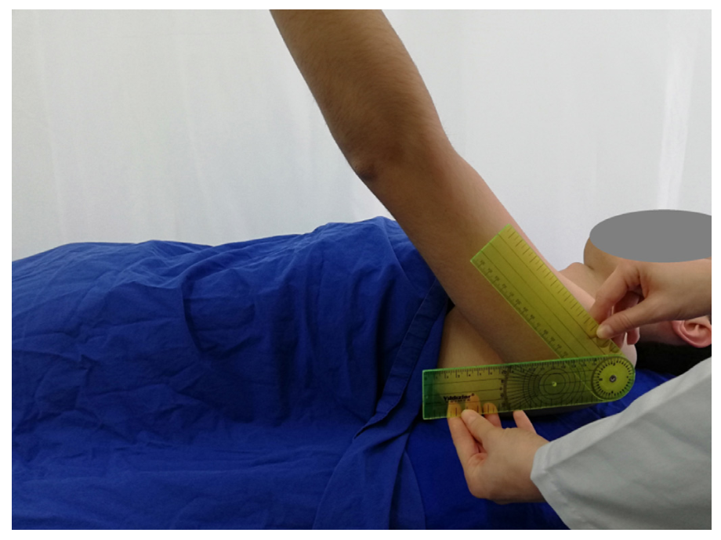
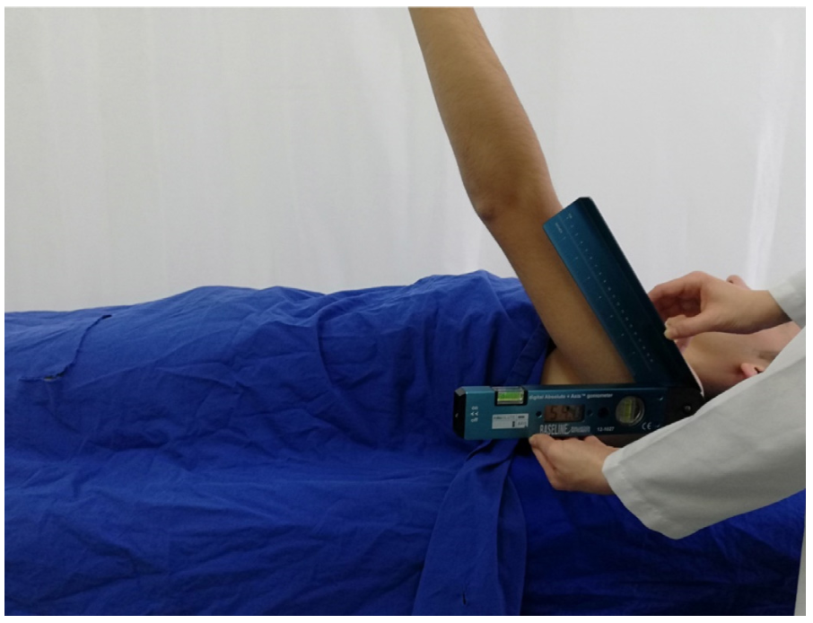
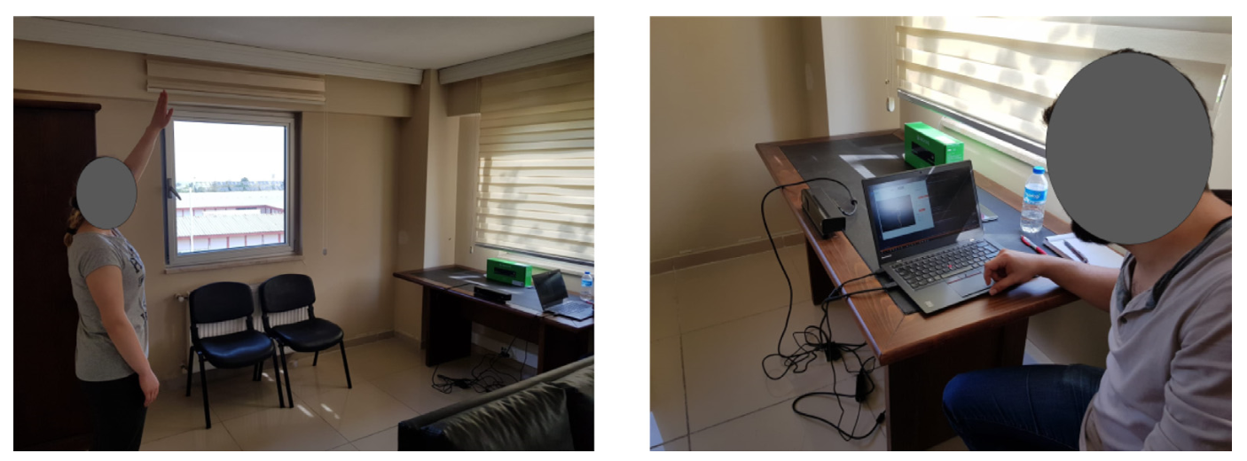
Methods
Participants:
40 healthy volunteers(22.08±3.11 years old, 170.85±8.78 cm, and 68.75±15.85 kg)
22 males (21.73±2.16 years old, 176.64±6.76 cm, and 75.18±14.82 kg)
18 females (22.50±4.00 years old, 163.78±4.91 cm, and 60.89±13.65 kg)
There was only one measurement by clinical and digital goniometers for each volunteer.
For Kinect V2 based measurement system, the shoulder motions of the participants were measured three times.
This study was approved by Bilecik Seyh Edebali University Ethics Committee (2017/04) and carried out in accordance with the Helsinki Declaration of the World Medical Association.
This work was supported by Bilecik Seyh Edebali University Coordinating Unit of Scientific Research Projects (2017-01.BS ̧ EÜ.03-04).
clinical goniometer
digital goniometer
Kinect

Slide 4
Procedures
Three measurement methods for shoulder motions:
The clinical goniometer is used as a standard 12-inch, 360° goniometer with two adjustable overlapping arms.
The digital goniometer displays degrees with 0.1° precision.
The Kinect V2 measurements were directed by the instructions of one expert physical therapist.
The goniometer measurements were made in the lie-down position.
The Kinect measurements were performed in the upright position.
The highest angle of the participants as possible was saved for each of the poses.

Slide 5
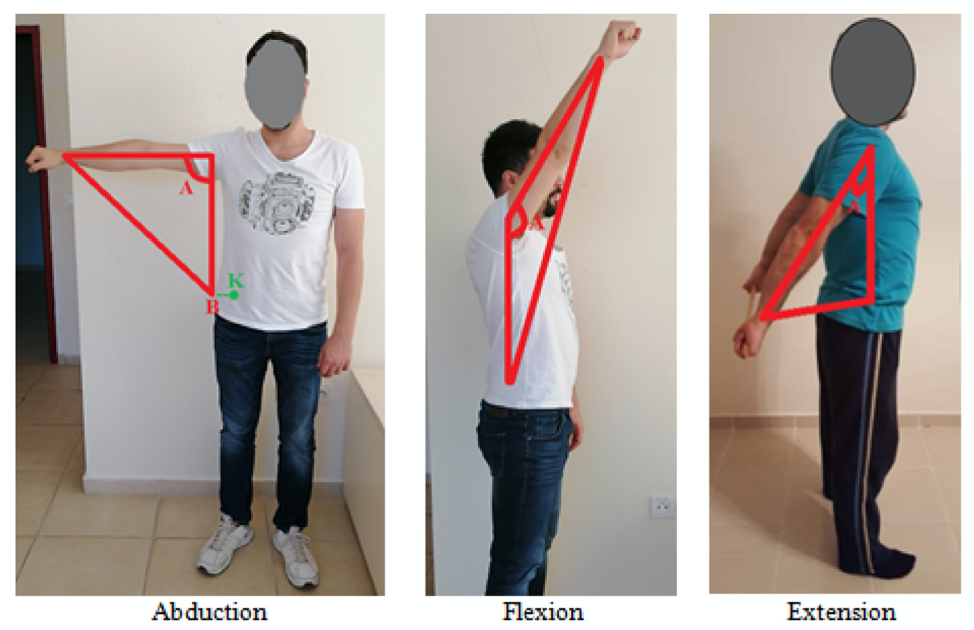
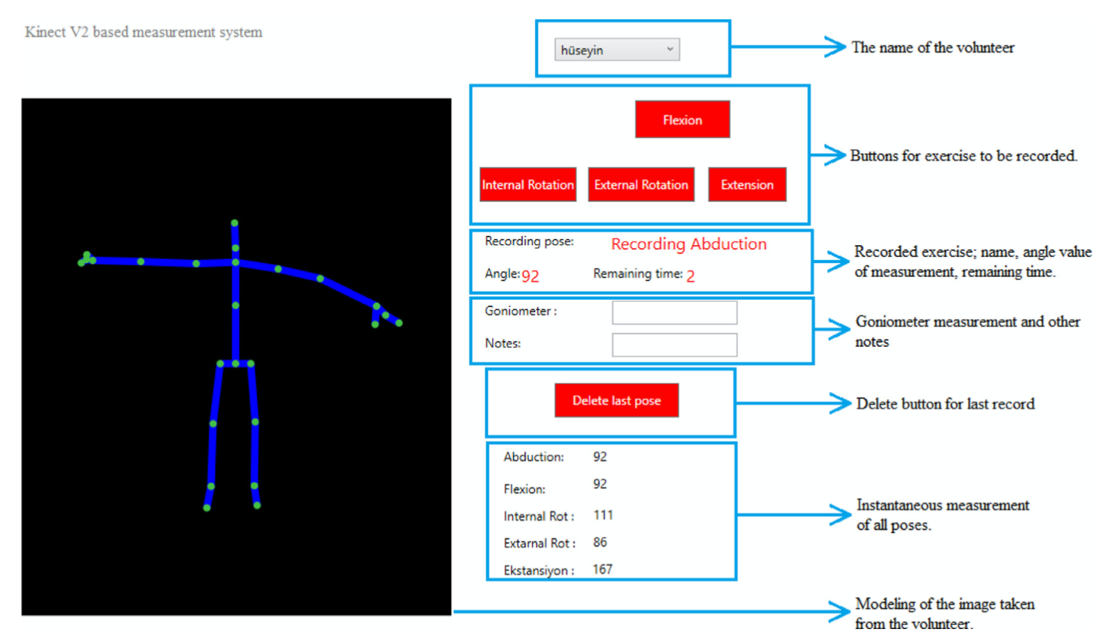
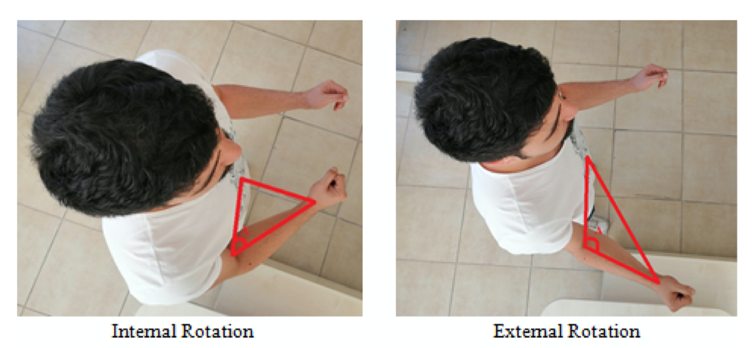
Kinect V2 based measurement system for shoulder motions
In this study, Kinect V2 and Kinect SDK 2.0 were used to measure the shoulder position angles.
Measure five basic motions
abduction, flexion, extension, internal rotation, external rotation

Slide 6
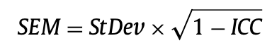
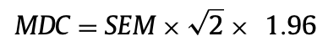
Statistical analyzes
In this study, statistical analyzes were obtained by using SPSS version 21 and Minitab 18.
Firstly, Kinect sensor data were assessed for normality using the Anderson–Darling test (p < 0.005).
According to the normality test results, the Kinect data was not normally distributed and therefore non-parametric statistics were used in this study.
reliability:
intraclass correlation coefficient (ICC) model
the standard error of the measurement (SEM)
minimal detectable change (MDC)
For validity test of the Kinect V2 based shoulder motion measurement system, Bland–Altman analysis is performed.
To show the absolute accuracy of Kinect V2 measurements over clinical and digital goniometers, limits of agreement (LOA, 一致性界限) and mean bias metrics(平均偏差度量) are used for five shoulder poses.
* The Anderson–Darling test is a statistical test of whether a given sample of data is drawn from a given probability distribution.
* Bland and Altman introduced the Bland-Altman (B&A) plot to describe agreement between two quantitative measurements.

Slide 7
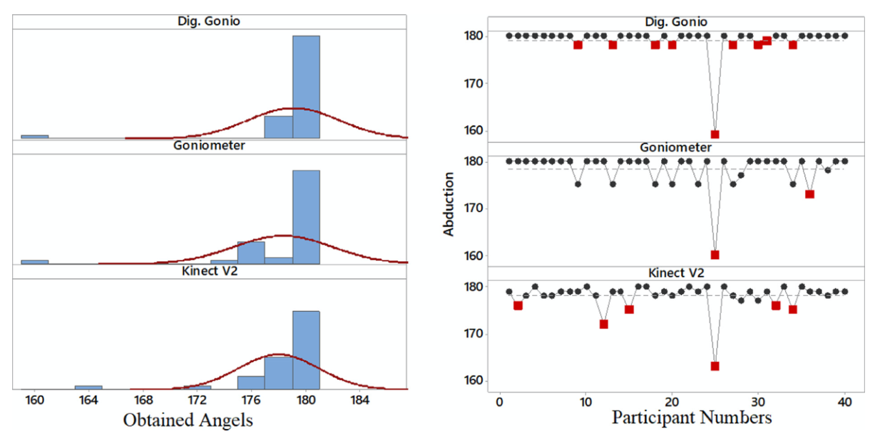
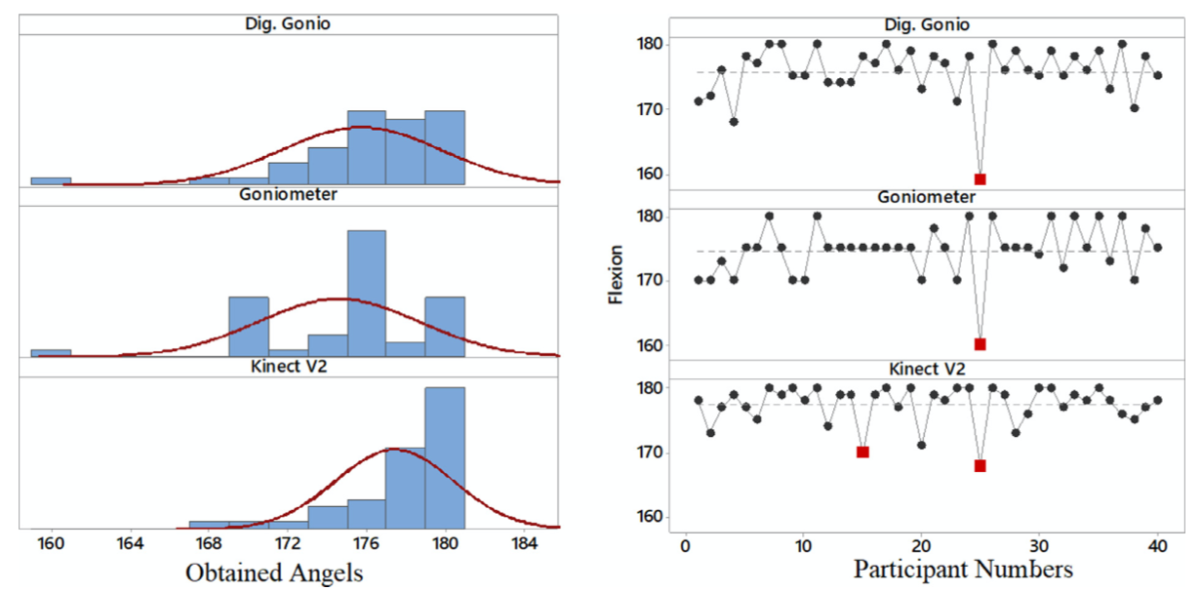
Results and discussion
Shoulder motion data
Left: the histogram graphics to present the distribution of data
Right: the participants’ shoulder ROM data in worksheet order
Figures have been drawn with summary report feature of Minitab software program.
The red dots indicate outliers of data.
Abduction data obtained using clinical/digital goniometers and Kinect V2
Flexion data obtained using clinical/digital goniometers and Kinect V2

Slide 8
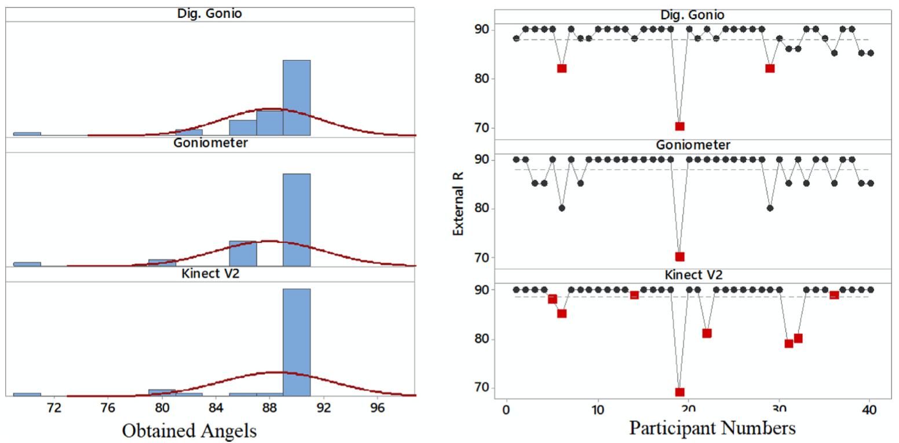
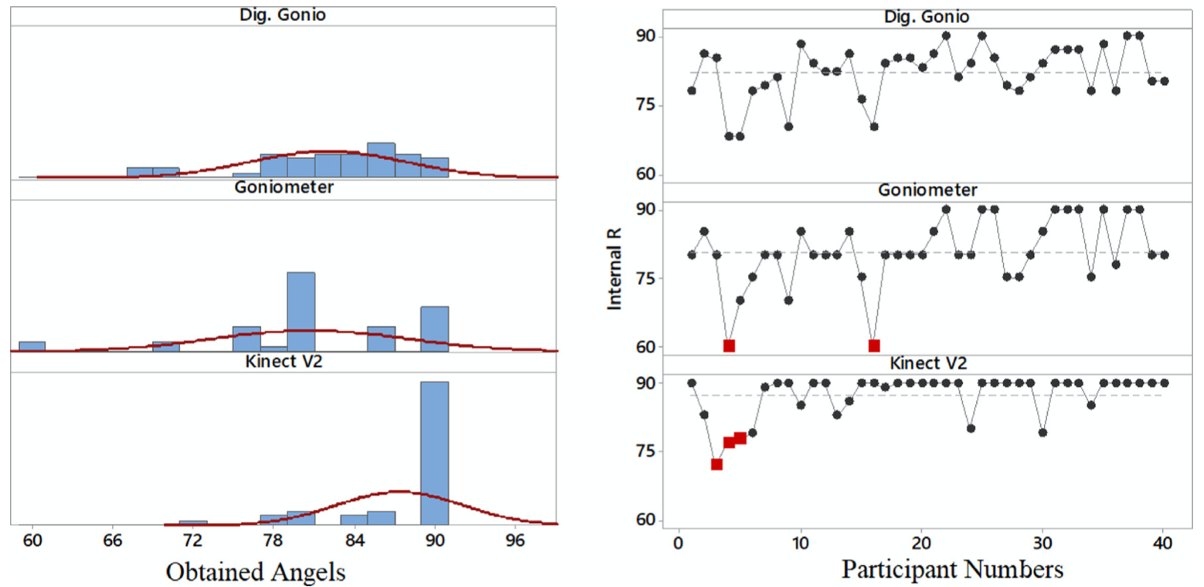
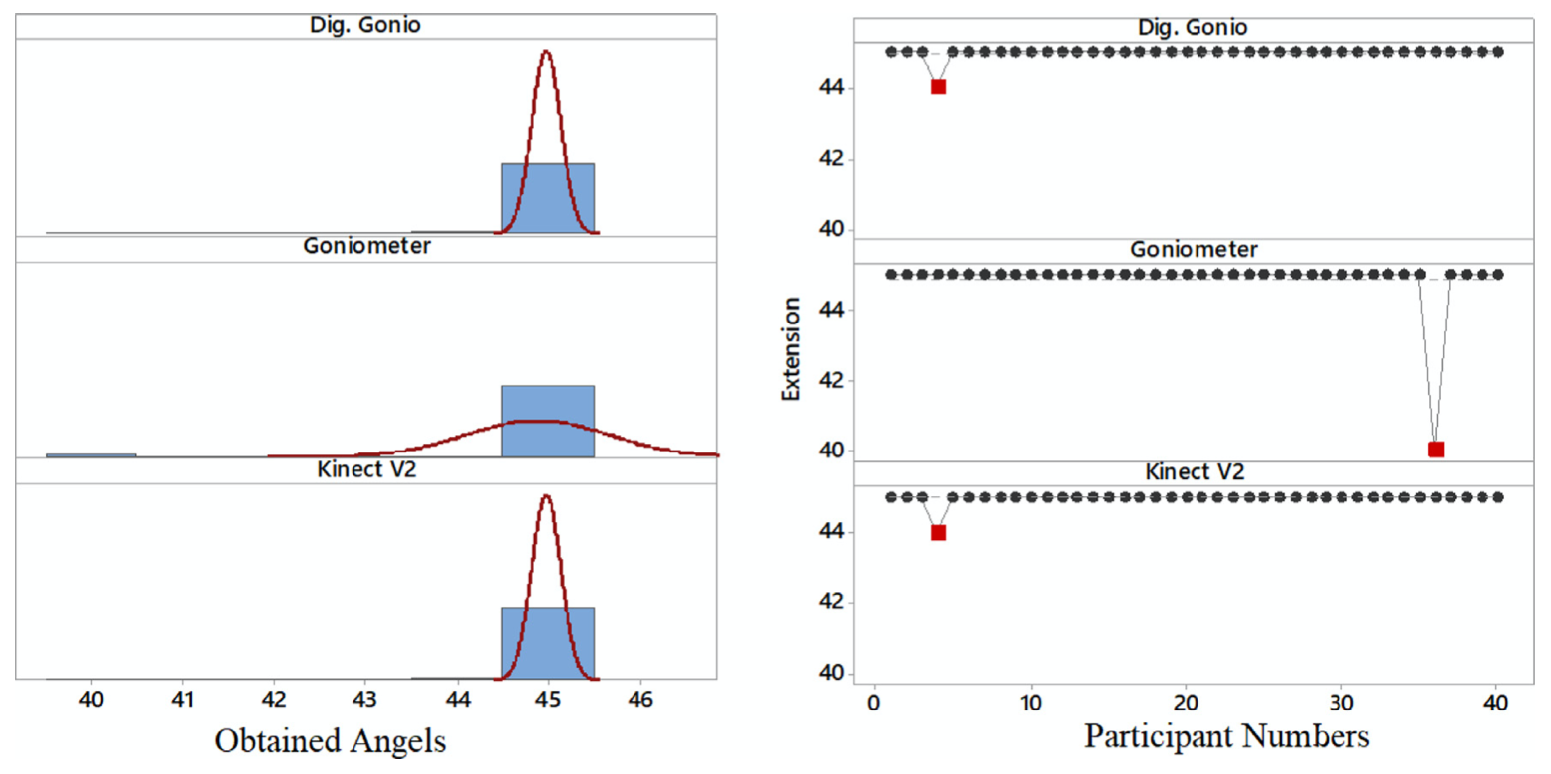
Results and discussion
Shoulder motion data
External rotation data obtained using clinical/digital goniometers and Kinect V2
Internal rotation data obtained using clinical/digital goniometers and Kinect V2
Extension data obtained using clinical/digital goniometers and Kinect V2

Slide 9
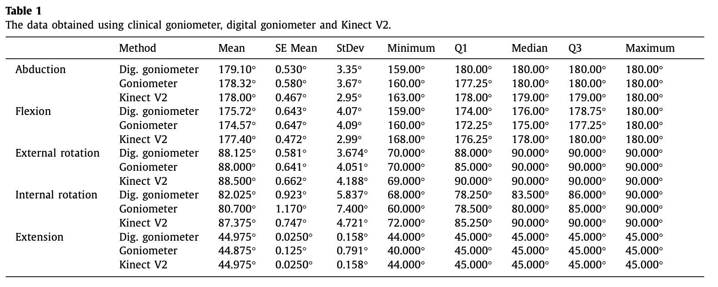
Results and discussion
Shoulder motion data
SE Mean: standard error of the mean;
StDev: standard deviation;
Q1: the “middle” value in the first half of the rank- ordered data set(25%分位数)
Q3: the “middle” value in the second half of the rank-ordered data set(75%分位数)

Slide 10
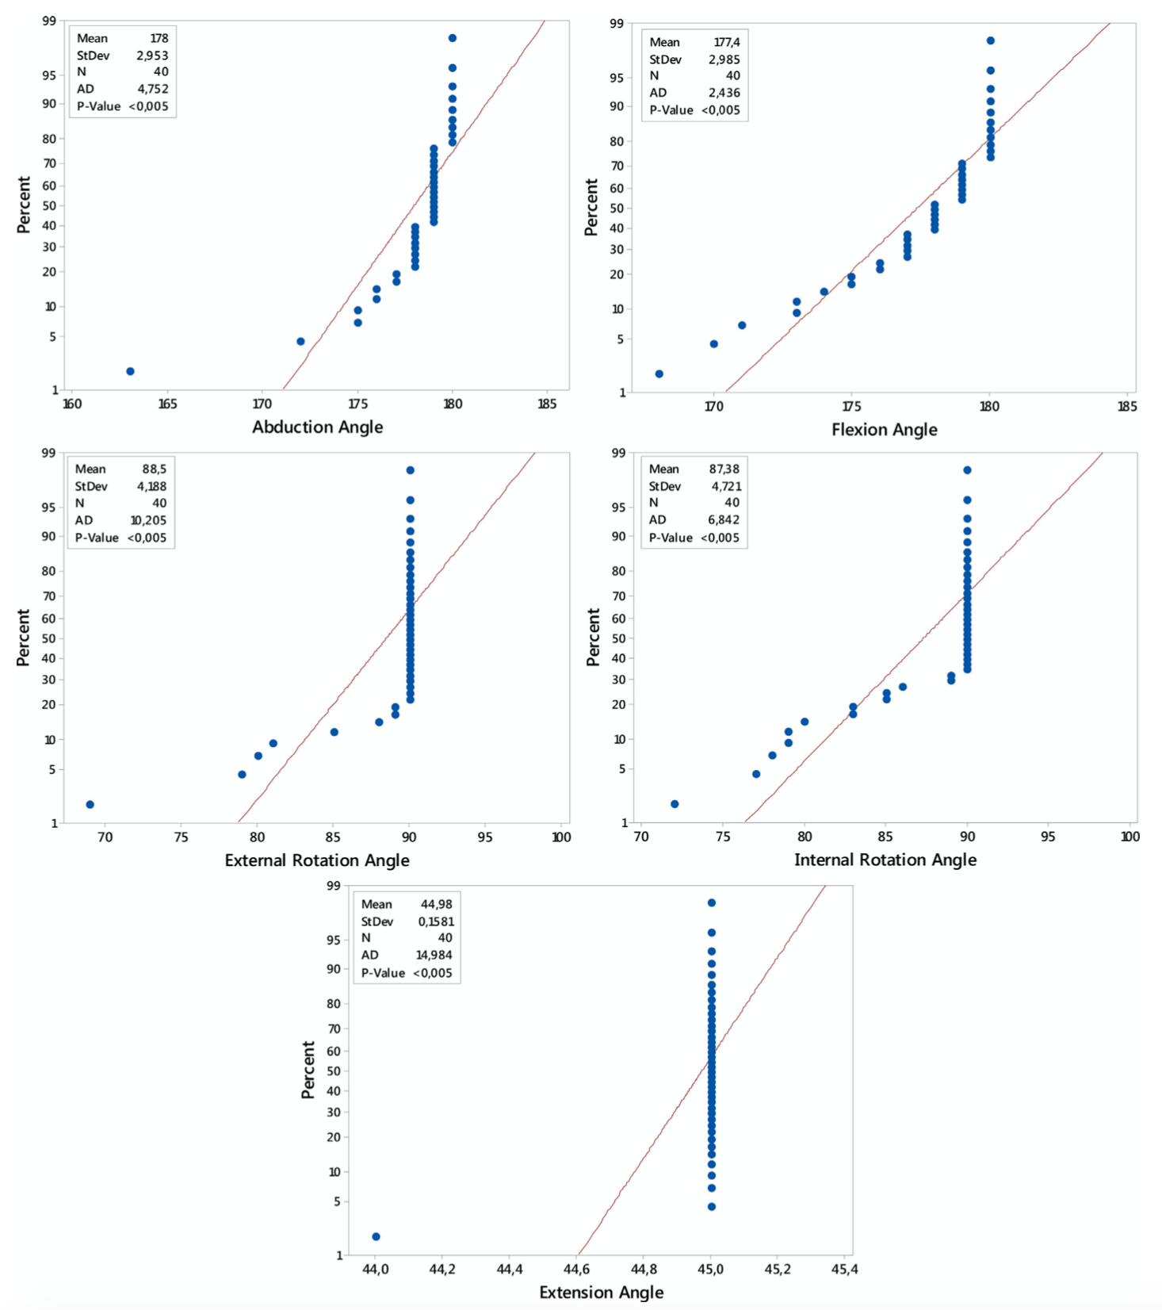
Results and discussion
Shoulder motion data
Kinect sensor data were evaluated according to the Anderson–Darling normality test (p < 0.005).
These data were not normally distributed and for that reason non-parametric statistic methods were used in this study.
Right figure shows the Anderson–Darling normality test results of Kinect sensor data for all shoulder poses.

Slide 11
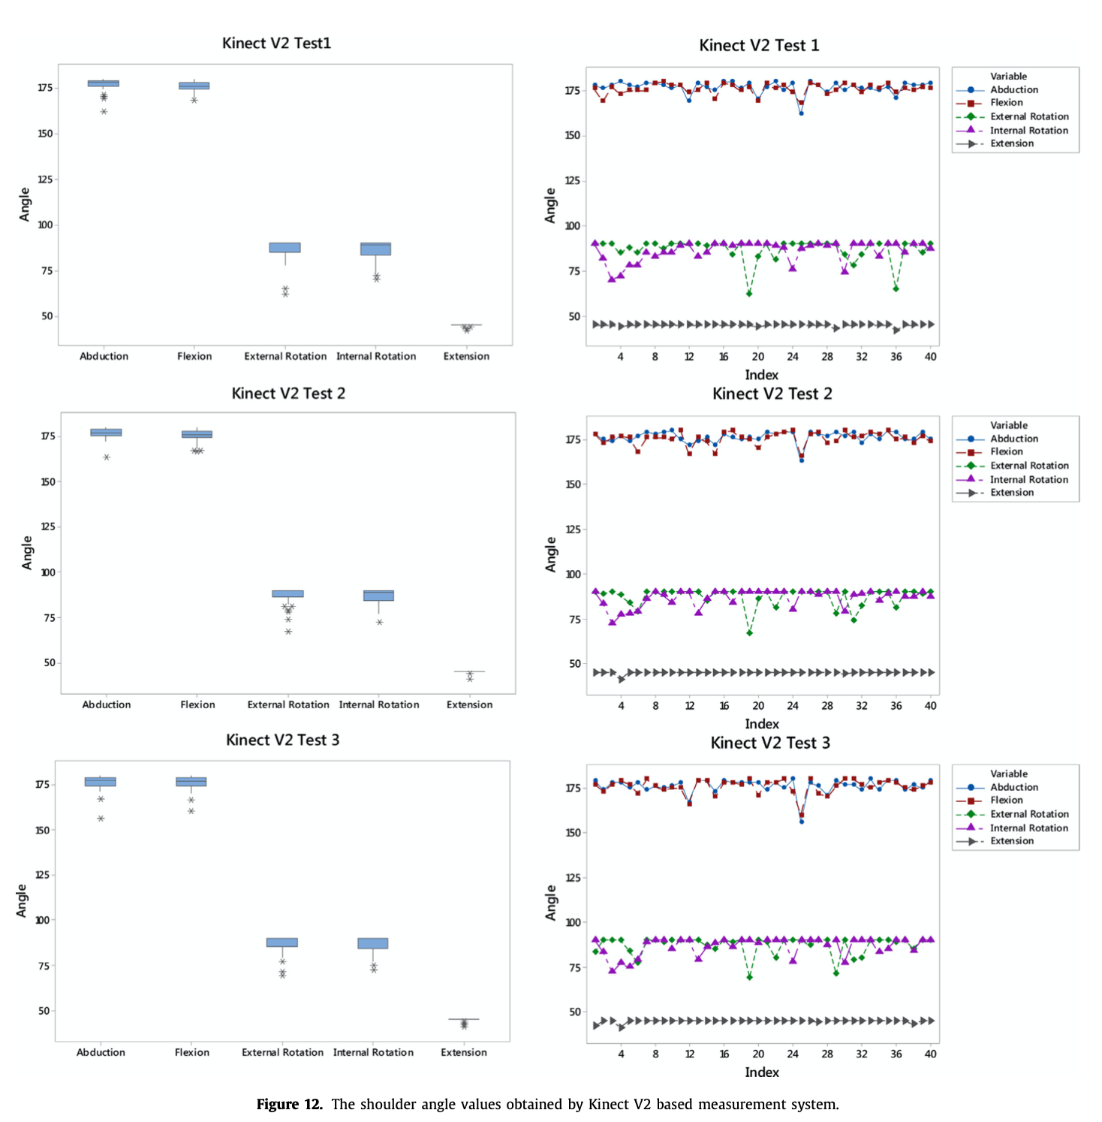
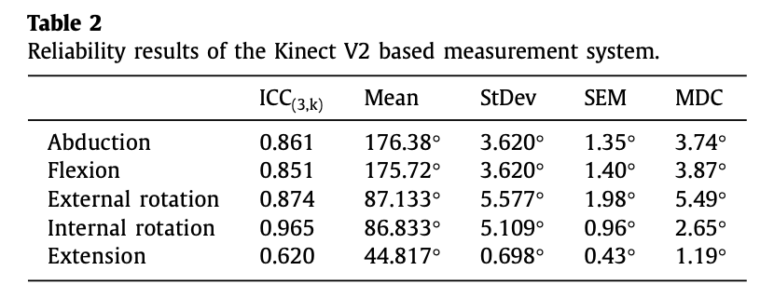
Results and discussion
Reliability result
For reliability analysis, the Kinect sensor measurements were taken three times from all participants.
This figure includes the box and line plots of the shoulder angle values obtained by Kinect V2 based system three times.
the high ICC metric values(reliability)
In terms of SEM and MDC metrics, the good reliability results were obtained for all poses due to their small values.

Slide 12
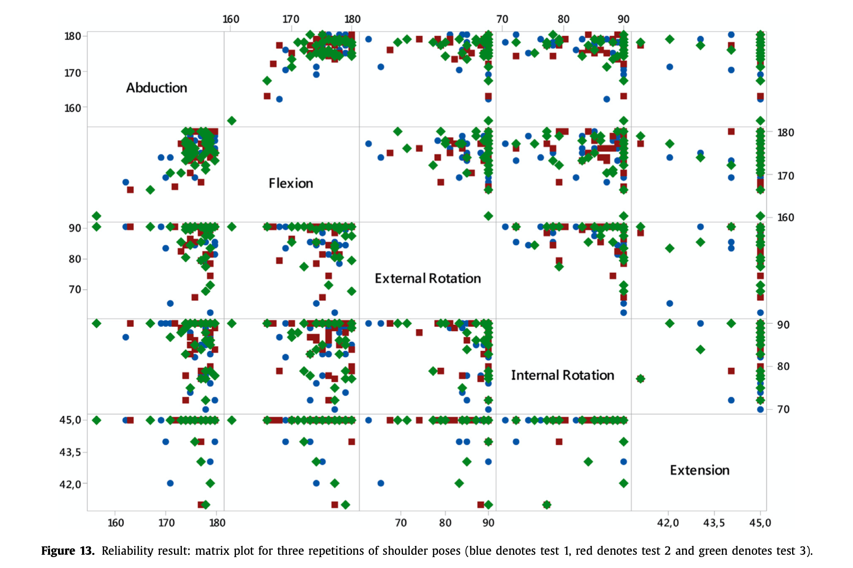
Results and discussion
Reliability result
the matrix plot: show the relationship among Kinect V2 repetition measurements
The subplot in the ith row and jth column of this figure is a scatter plot of the shoulder poses taken by the proposed Kinect V2 based measurement system for three repetitions.

Slide 13
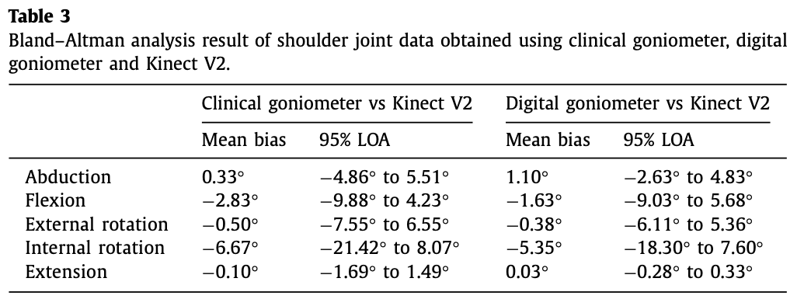
Results and discussion
Validity result
The 95% limits of agreement (LOA) between Kinect V2 based measurement system and the two goniometer systems were calculated for five shoulder poses to show the validity of the proposed system.
Clinical Goniometer-Kinect V2: 0.33° (abduction), −2.83° (flexion), −0.50° (external rotation), −6.67° (internal rotation) and −0.10° (extension)
Digital Goniometer-Kinect V2: 1.10° (abduction), −1.63° (flexion), −0.38° (external rotation), −5.35° (internal rotation) and 0.03° (ex- tension).
According to the LOA results, the 95% LOA exceeded ±5° for the discrepancy between Kinect V2 based system and two goniometers for all shoulder poses except extension, and this was considered to be clinically significant.

Slide 14
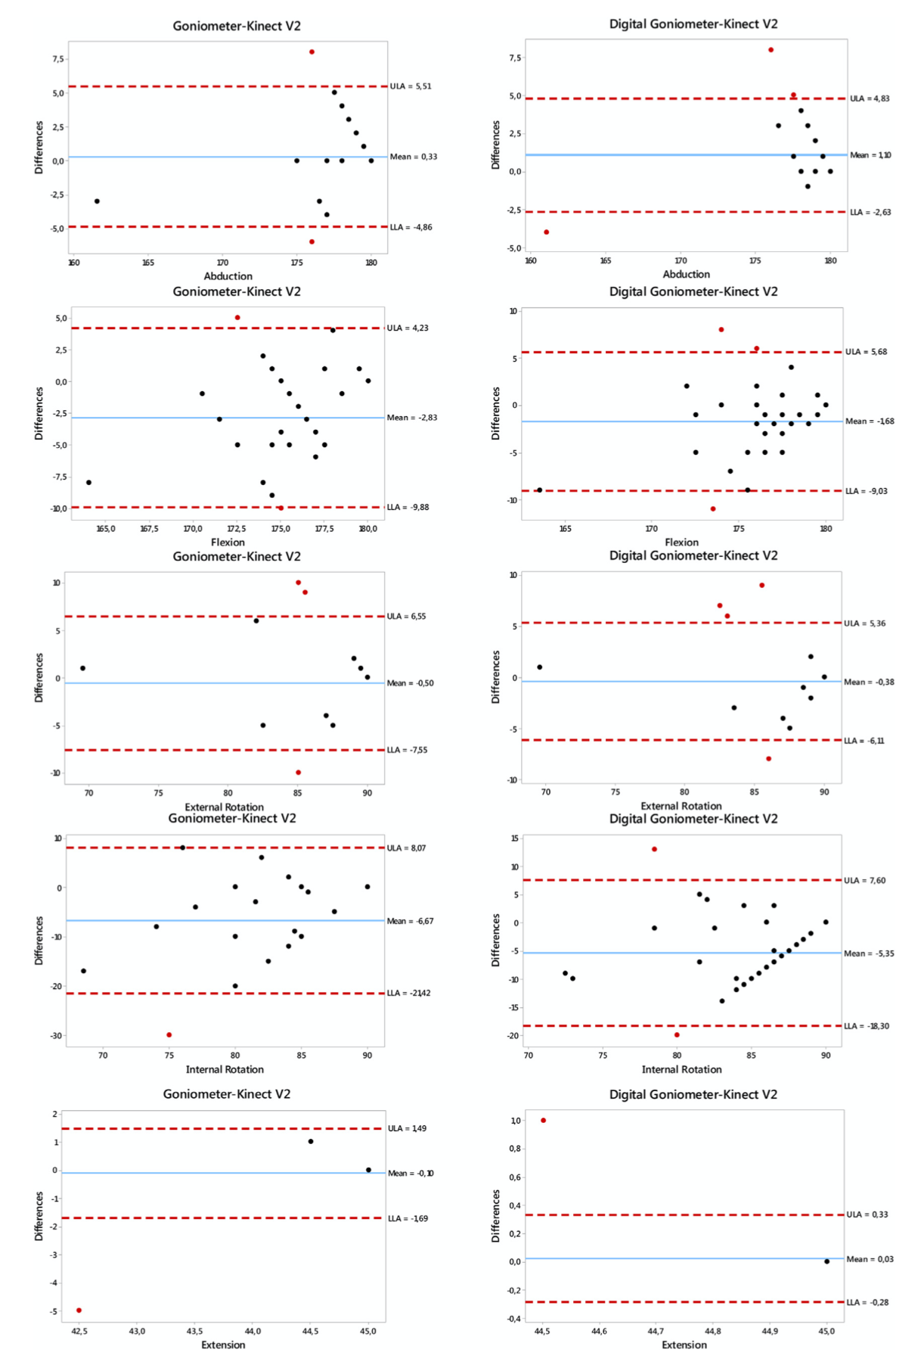
Results and discussion
Validity result
Bland–Altman analysis results are shown in right figure for all shoulder poses.
The comparison between Kinect V2 and clinical goniometer is at the left column of this figure and the comparison between Kinect V2 and digital goniometer is at the right column of this figure.
As can be seen from this figure, the differences of the shoulder pose angles obtained by two measurement systems does not distribute in a systematic way, but a random distribution for all shoulder poses except extension pose.

Slide 15
Conclusion
The proposed system consists of Kinect V2 sensor and graphical user interface.
The reliability test results show that Kinect V2 based measurement system is very good for abduction, flexion, internal rotation, external rotation poses, and has good reliability for extension pose.
In the 95% LOA results of all exercises, it was observed that Kinect V2 based measurement system gives closer results to the digital goniometer than the clinical goniometer.
According to the Bland–Altman analysis results, it is evident that the proposed Kinect V2 based shoulder motion measurement system is an alternative and effective method in comparison with both of the goniometers.
The obtained results are promising for the development of home-based rehabilitation systems using Kinect that is a low cost motion capture sensor.
In future works, the proposed measurement system can be applied to patients for treatment.

